Slide 1
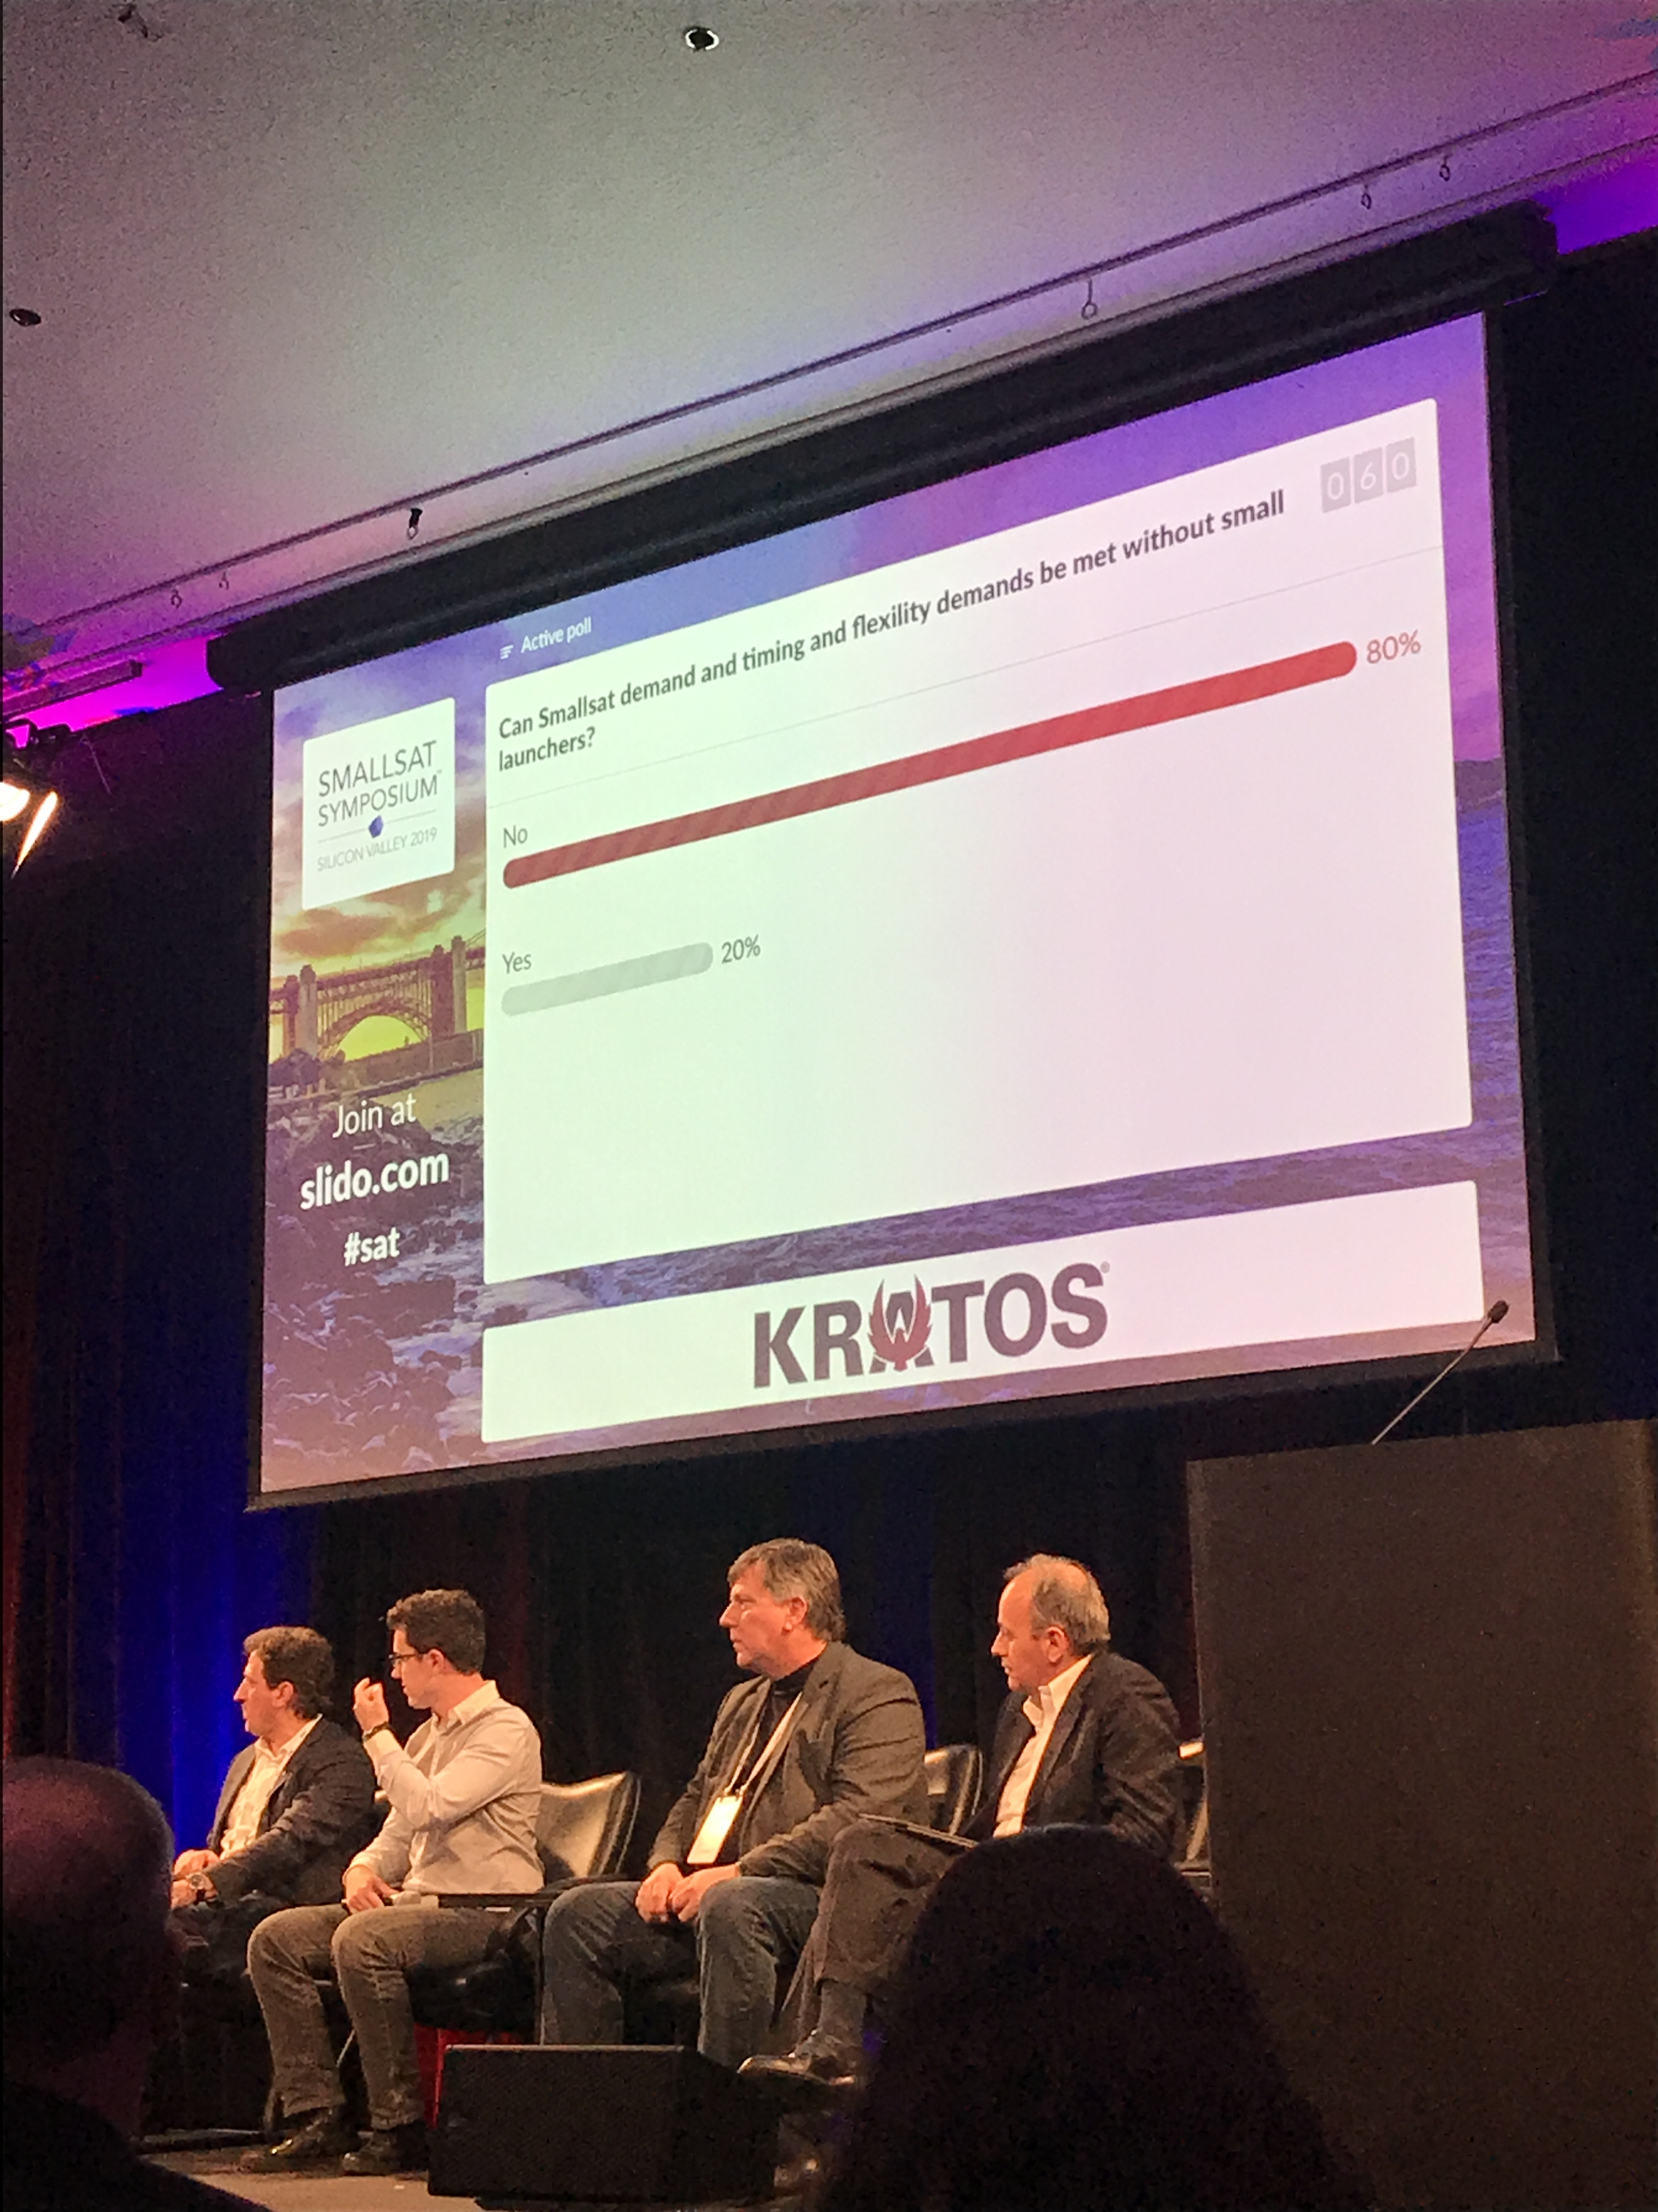
SmallSat Symposium
Industry event focused on small satellites
Launch
Hardware
Ground-station
Analysis
Three main takeaways
Business case for SmallSats not proven
Contractions in small launch
Ground station hardware needs the most technical development
Can Smallsat demand and timing and flexibility
demands be met without small launchers?

Slide 2
Analysis
EO data saturated
Trouble reaching out to markets
Constellation-hype
Planet
OneWeb/Starlink
Telesat
FCC issues
Propulsion
Electric becoming modular
Accelerating testing/production
CubeSat challenges overcome
Air-breathing
Loon
Intelligent network (sats communicate)
Delay tolerant network
Remote procedure calling
Software defined networking (in addition to SDR)
Antennas
Electrically steerable phased arrays key to many platforms
Cost needs to come down by an order of magnitude to be commercially viable

